Slide 1
Collaboration Diagrams

Slide 2
What is a Collaboration Diagram
Collaboration diagrams illustrate interactions between objects
The collaboration diagram illustrates messages being sent between classes and objects (instances).
Collaboration diagrams express both the context of a group of objects (through objects and links) and the interaction between these objects (by representing message broadcasts)

Slide 3
Purpose of the Collaboration Diagram
They are very useful for visualizing the relationship between objects collaborating to perform a particular task
They provide a good view of interaction between objects which may be difficult to see at the class level

Slide 4
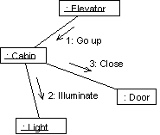
Ex. Collaboration Diagram

Slide 5
Collaboration Diagram Elements
There are three primary elements of a collaboration diagram:
  Objects
  Links
  Messages

Slide 6
Collaboration Diagram Syntax
AN ACTOR
AN OBJECT
Link
A MESSAGE
anObject:aClass
aMessage()

Slide 7
Objects
Objects­rectangles containing the object signature­object signature:
  object name : object Class
  object name (optional) - starts with lowercase letter
  class name (mandatory) - starts with uppercase letter

Slide 8
Links
The connecting lines drawn between objects are links
They enable you to see the relationships between objects
This symbolizes the ability of objects to send messages to each other
A single link can support one or more messages sent between objects

Slide 9
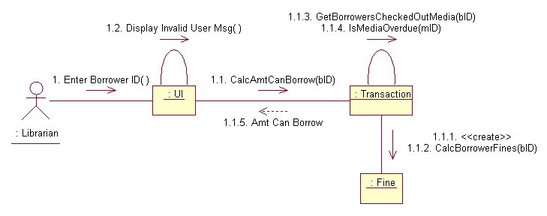
The visual representation of a link is a straight line between two objects. If an object sends messages to itself, the link carrying these messages is represented as a loop icon. This loop can be seen on both the UI object and the Transaction object.

Slide 10
Messages
An interaction is implemented by a group of objects that collaborate by exchanging messages
Messages in collaboration diagrams are shown as arrows.
Typically, messages represent a client invoking an operation on a supplier object

Slide 11
Messages
Message icons have one or more messages associated with them
Messages are composed of message text prefixed by a sequence number
Time is not represented explicitly in a collaboration diagram, and as a result the various messages are numbered to indicate the sending order

Slide 12
Flow by Number

Slide 13
Flow by Numbers
1. Enter Borrower ID
1.1 CalcAmtCanBorrow
1.1.1 <<create>>
1.1.2 CalcBorrowerFines
1.1.3 GetBorrowersCheckedOutMedia
1.1.4 IsMediaOverdue
1.1.5 Amt Can Borrow
1.2 Display Invalid User Msg

Slide 14
Message Flow Notation
Same as for sequence diagrams
  Synchronous
Flow of control
Asynchronous
Return

Slide 15
Collaboration vs Sequence Diagram
In reality, sequence diagrams and collaboration diagrams show the same information, but just present it differently

Slide 16
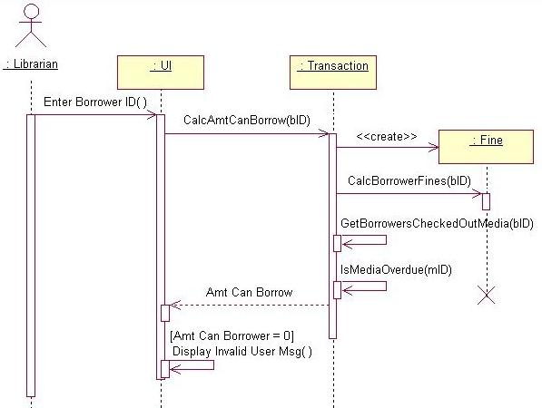
Sequence diagram is better at ‘time ordering’

Slide 17
Collaboration diagram is better at showing the relationship between objects

Slide 18
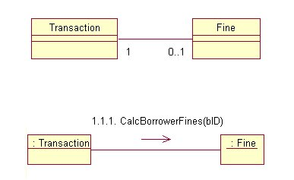
Collaboration and Class Diagrams
Links in a collaboration diagram directly correlate to associations between classes in a class diagram

Slide 19
Steps to Creating a Collaboration Diagram
Determine the scope of the diagram- the use case it relates to
Place the objects that participate in the collaboration on the diagram
  Remember to place the most important objects towards the center of the diagram.
If a particular object has a property or maintains a state that is important to the collaboration, set the initial value of the property or state

Slide 20
Steps to Creating a Collaboration Diagram
Create links between the objects
Create messages associated with each link
Add sequence numbers to each message corresponding to the time-ordering of messages in the collaboration

Slide 21
Creation and Deletion
Unlike sequence diagrams, you don't show an object's lifeline in a collaboration diagram
If you want to indicate the lifespan of an object in a collaboration diagram, you can use create and destroy messages to show when an object is instantiated and destroyed

Slide 22
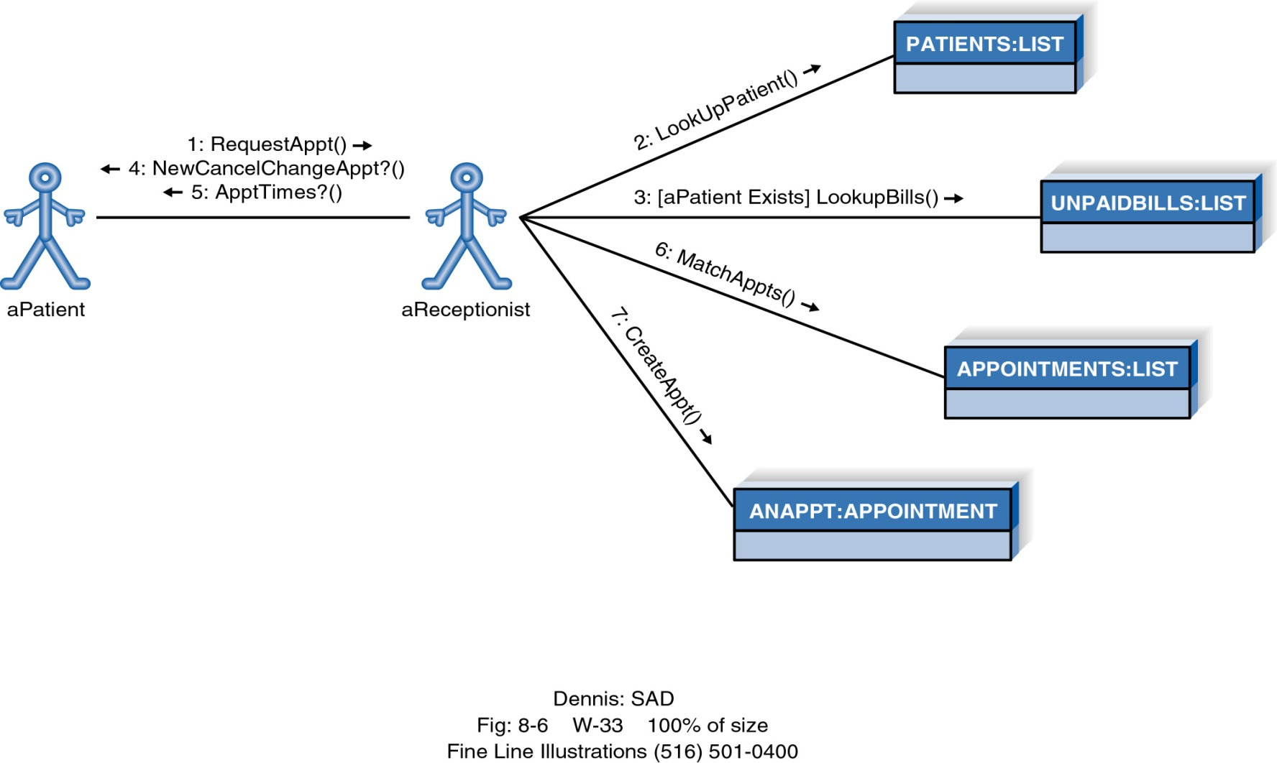
Example Collaboration Diagram

Slide 23
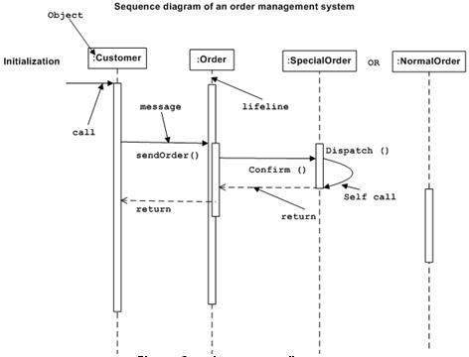

Slide 24
